Slide 1

Multi Task Learning on Face Images with a Task Constrained Deep Convolutional Neural Network
Emanuele Alessi
Gianmarco Forcella
July 8, 2019

Slide 2
Multi Task Learning
In Computer Vision tasks, it is often asked to have a Neural Network that is capable of learning and predicting more things at once. While sometimes this resolves in having more than one Network for every single task, this became inefficient in a very short time.
In the early 2000s, though, researchers finally proposed a “way out” to this problem. If we humans can be multitasking, so can computers and, so, can neural networks.
Today’s presentation will focus on a implementation proposal of a TCDCN
Multi Task Learning on Face Images with a Task Constrained Deep Convolutional Neural Network
Using Social Media to Enhance Emergency Situation Awareness

Slide 3


Reference
We have based our approach on the paper Xxx and XXXin which they tried to resolve this kind of problem implementing this system architecture.
We focused on the prediction of six cases
They’ve used a Task Constrained Neural Network
We replicate their method, adding a more recent Neural Network approach (due to papers’s age)
Using SocialMedia to Enhance Emergency Situation Awareness
Multi Task Learning on Face Images with a Task Constrained Deep Convolutional Neural Network

Slide 4
Our proposal
We decised to propose a model that is based on:
L2 Regularization
Batch Normalization
Using SocialMedia to Enhance Emergency Situation Awareness
Multi Task Learning on Face Images with a Task Constrained Deep Convolutional Neural Network

Slide 5
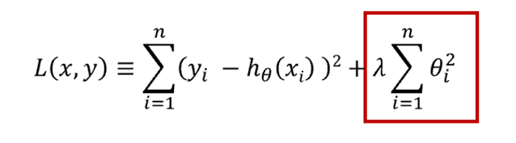
L2 Regularization
It allows to apply penalties on layer parameters during optimization
These penalties are incorporated in the loss function that the network optimizes
Using SocialMedia to Enhance Emergency Situation Awareness
Multi Task Learning on Face Images with a Task Constrained Deep Convolutional Neural Network

Slide 6
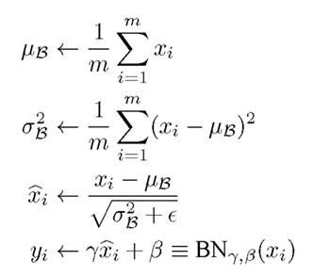
Batch Normalization
It normalizes the activation of the previous layer at each batch
It also acts as a regularizer, in some cases eliminating the need for Dropout
Using SocialMedia to Enhance Emergency Situation Awareness
Multi Task Learning on Face Images with a Task Constrained Deep Convolutional Neural Network

Slide 7
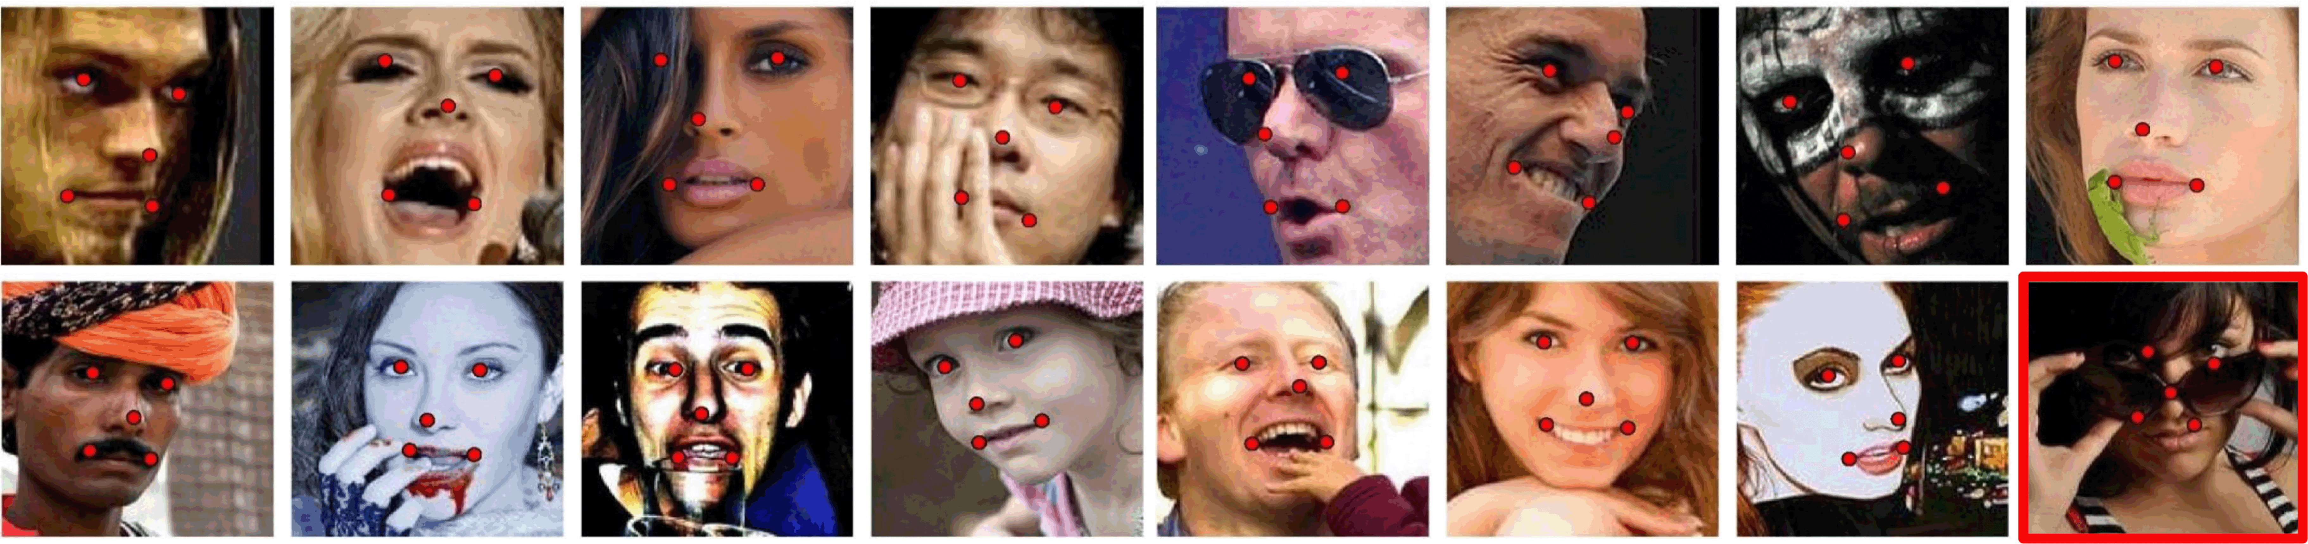
MAFL dataset
We used MAFL (Multi Attribute Facial Landmarks), which is a subset of CelebA
It is annotated with 5 facial landmarks and 40 different facial attributes
19000 images for training
1000 images for testing
Using SocialMedia to Enhance Emergency Situation Awareness
Multi Task Learning on Face Images with a Task Constrained Deep Convolutional Neural Network

Slide 8

Tensorflow
An open source machine learning
Developed by Google
The most used nowadays
It guarantees a very efficient computation
Multi Task Learning on Face Images with a Task Constrained Deep Convolutional Neural Network

Slide 9
Our TCDCN
Using SocialMedia to Enhance Emergency Situation Awareness
Multi Task Learning on Face Images with a Task Constrained Deep Convolutional Neural Network

Slide 10
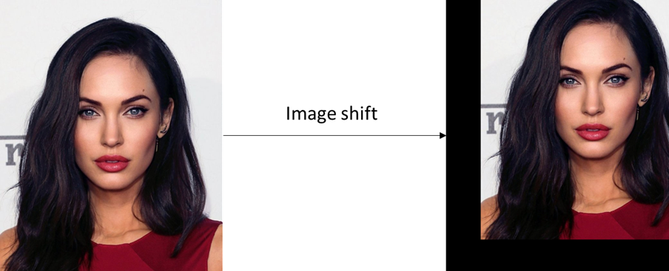
Training phase
We trained the TCDCN (for 4 epochs) with:
Batch size=32 (32 images per step)
Adam optimizer
Learning rate=0.001
Image Augmentation (width and height shift)
Using SocialMedia to Enhance Emergency Situation Awareness
Multi Task Learning on Face Images with a Task Constrained Deep Convolutional Neural Network

Slide 11
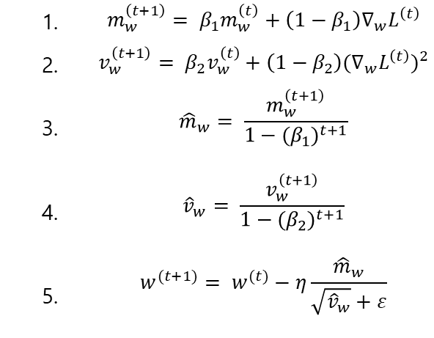
Adam optimization algorithm
Adam can be looked at as a combination of RMSprop and Stochastic Gradient Descent with momentum.
1. | $$m_{w}^{\left(t+1\right)}= β_{1}m_{w}^{\left(t\right)}+\left(1−β_{1}\right)∇_{w}L^{\left(t\right)}$$
2. | $$v_{w}^{\left(t+1\right)}= β_{2}v_{w}^{\left(t\right)}+\left(1−β_{2}\right){{(∇}_{w}L^{\left(t\right)})}^{2}$$
3. | $${\hat{m}}_{w}= \frac{m_{w}^{\left(t+1\right)}}{1−{(β_{1})}^{t+1}}$$
4. | $${\hat{v}}_{w}= \frac{v_{w}^{\left(t+1\right)}}{1−{(β_{2})}^{t+1}}$$
5. | $$w^{(t+1)}= w^{(t)}−η\frac{{\hat{m}}_{w}}{\sqrt{{\hat{v}}_{w}}+ε}$$
Using SocialMedia to Enhance Emergency Situation Awareness
Multi Task Learning on Face Images with a Task Constrained Deep Convolutional Neural Network

Slide 12
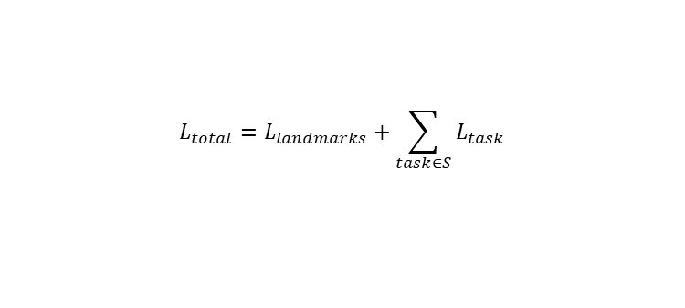

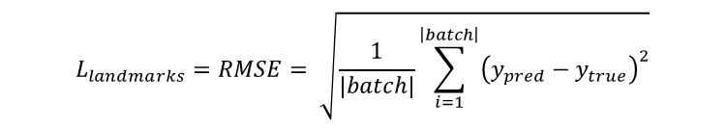
Loss functions
RMSE for landmarks localization
Softmax cross entropy for the other tasks
$$L_{landmarks}=RMSE= \sqrt{\frac{1}{\left|batch\right|}\sum_{i=1}^{\left|batch\right|}{{\left(y_{pred}−y_{true}\right)}^{2}}}$$
$$L_{task}= H\left(y_{pred}{,y}_{true}\right)=− \frac{1}{\left|batch\right|} \sum_{i=1}^{\left|batch\right|}{y_{true}}\log\left(y_{pred}\right)$$
Using SocialMedia to Enhance Emergency Situation Awareness
$$L_{total}=L_{landmarks}+\sum_{task∈S}{L_{task}}$$
Multi Task Learning on Face Images with a Task Constrained Deep Convolutional Neural Network

Slide 13
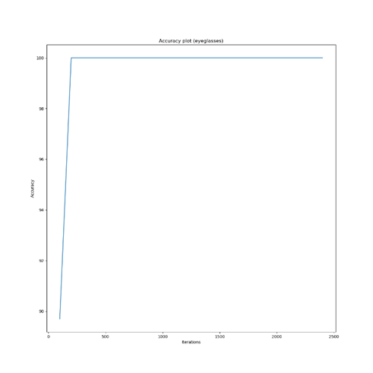
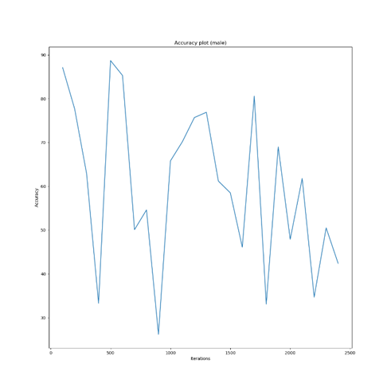
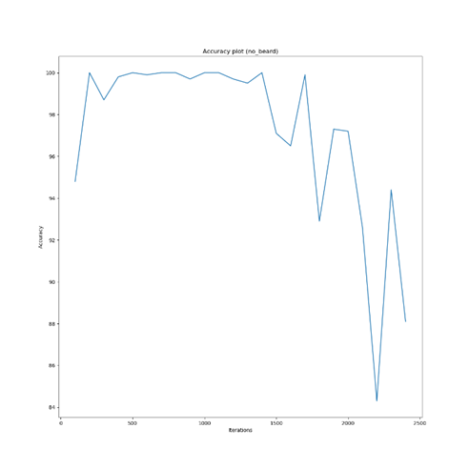
Accuracies
Eyeglasses
Gender
Facial hairs
Multi Task Learning on Face Images with a Task Constrained Deep Convolutional Neural Network

Slide 14
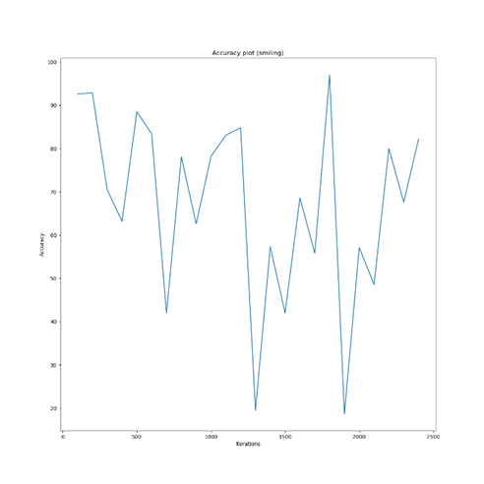
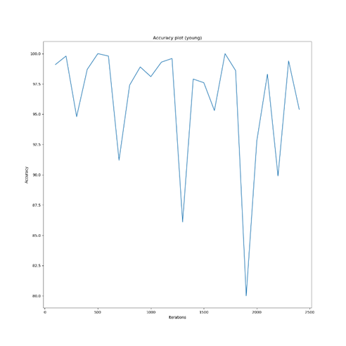
Accuracies (2)
Smile
Age
Multi Task Learning on Face Images with a Task Constrained Deep Convolutional Neural Network

Slide 15
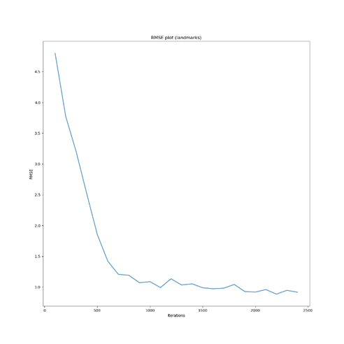
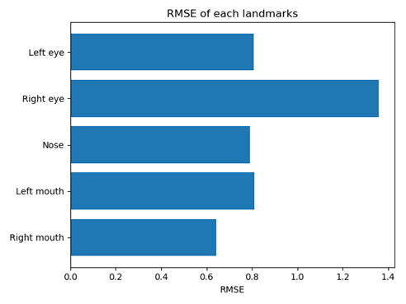
RMSE Landmarks
Multi Task Learning on Face Images with a Task Constrained Deep Convolutional Neural Network

Slide 16
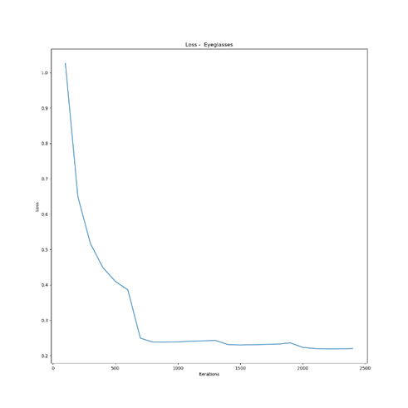
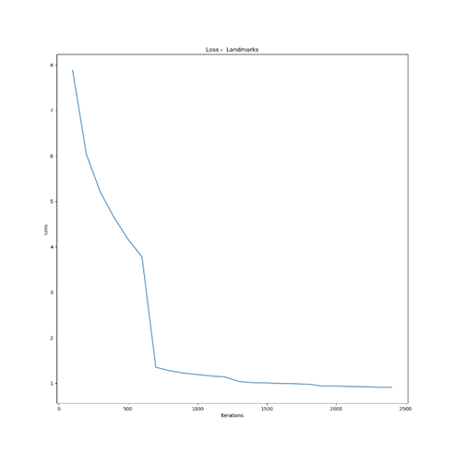
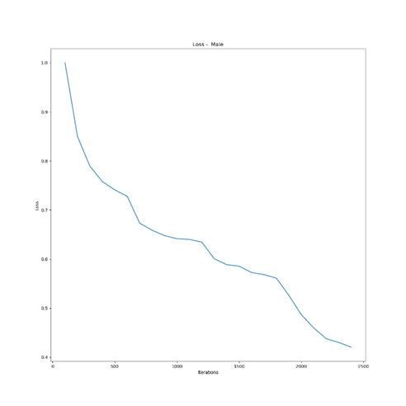
Losses
Eyeglasses
Landmarks
Gender
Multi Task Learning on Face Images with a Task Constrained Deep Convolutional Neural Network

Slide 17
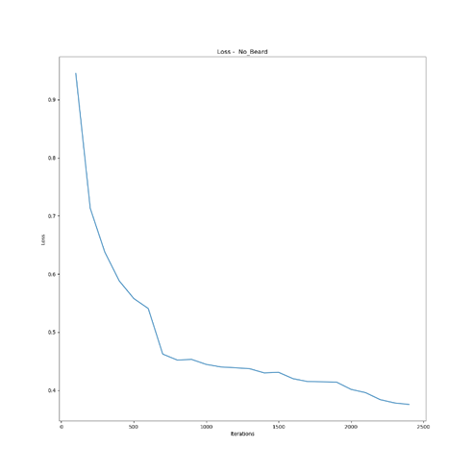
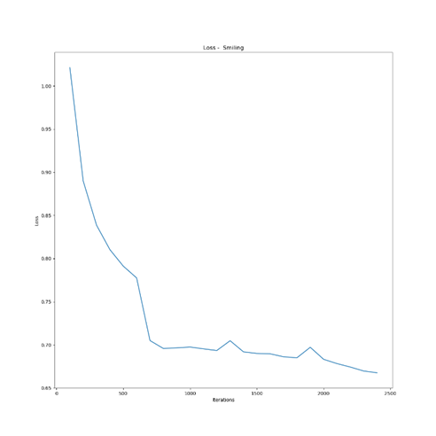
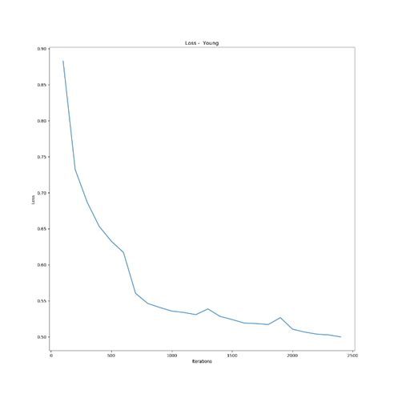
Losses (2)
Facial hairs
Smile
Age
Multi Task Learning on Face Images with a Task Constrained Deep Convolutional Neural Network

Slide 18
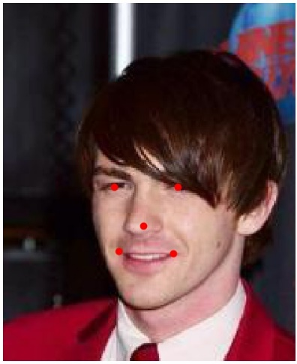
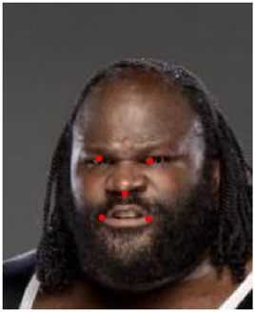
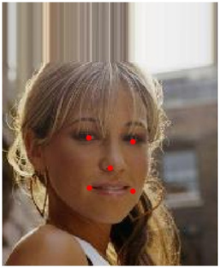
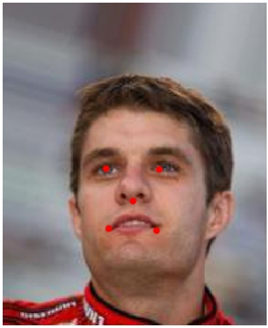
Landmarks localization
Multi Task Learning on Face Images with a Task Constrained Deep Convolutional Neural Network

Slide 19
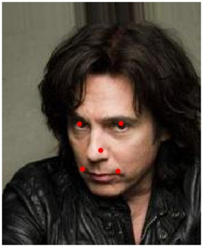
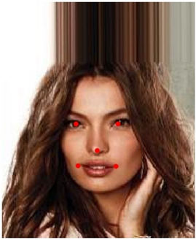
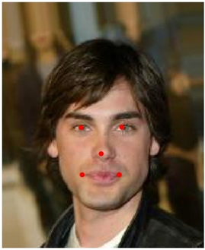
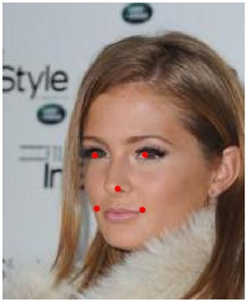
Landmarks localization (2)
Multi Task Learning on Face Images with a Task Constrained Deep Convolutional Neural Network

Slide 20
Thanks for the attention
Multi Task Learning on Face Images with a Task Constrained Deep Convolutional Neural Network

